Slide 1
Data Visualization & Interpretation
Febin.A.Vahab

Slide 2
Discussion: Color Considerations
Color grabs attention
Color can signal where to look
Color should be used sparingly
Color can carry quantitative value
Color carries tone and meaning
Not everyone sees color
Color should be used consistently

Slide 3
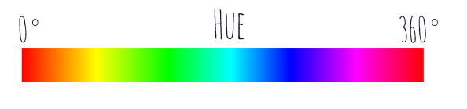
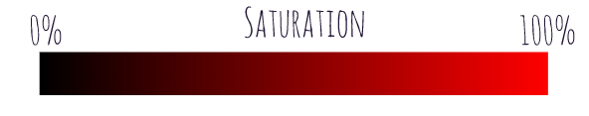
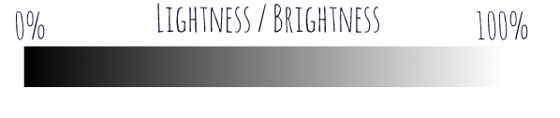
HSL

Slide 4
Color palettes
Three major types of color palette exist for data visualization
Qualitative palettes: when the variable is categorical in nature.
Sequential palettes: the variable is numeric or has inherently ordered values, then it can be depicted with a sequential palette
Diverging palettes: If our numeric variable has a meaningful central value, like zero, then we can apply a diverging palette.

Slide 5
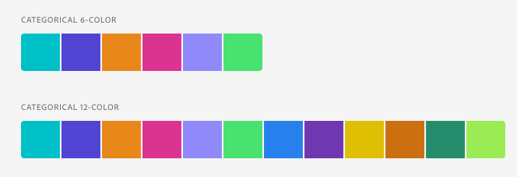
Color palettes-Qualitative

Slide 6
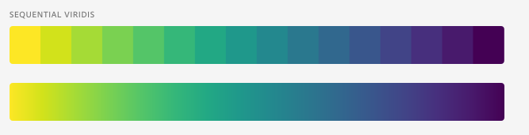
Color palettes-Sequential

Slide 7
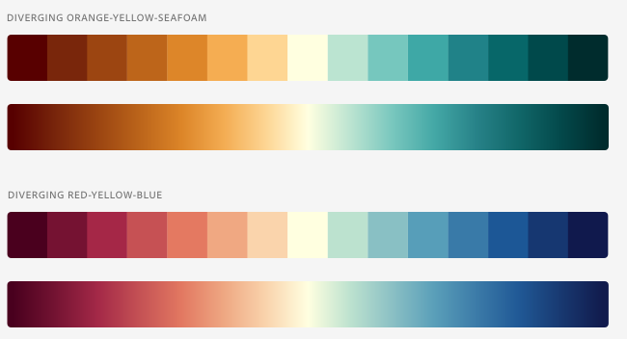
Color palettes-Diverging

Slide 8
Color meaning chart

Slide 9
A few tips

Slide 10
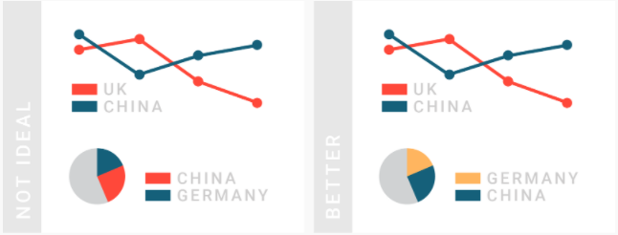
Consider using the same color for the same variables

Slide 11
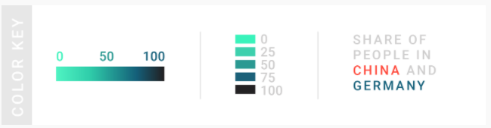
Make sure to explain to readers what your colors encode

Slide 12
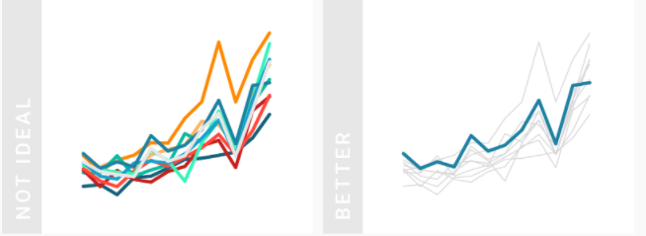
Consider the color grey as the most important color in Data Viz

Slide 13
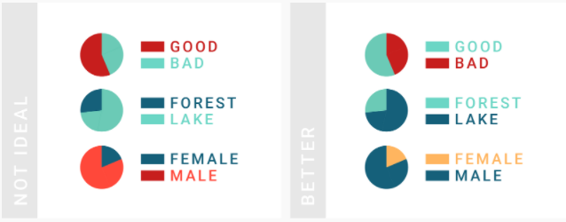
Use intuitive colors

Slide 14
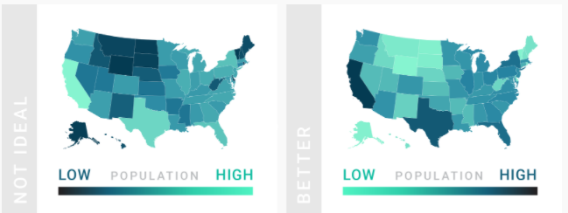
Use light colors for low values and dark colors for high values

Slide 15
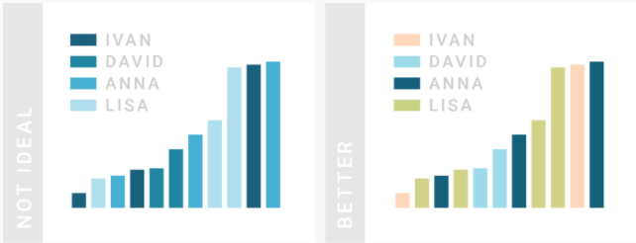
Don’t use a gradient color palette for categories and the other way round.

Slide 16
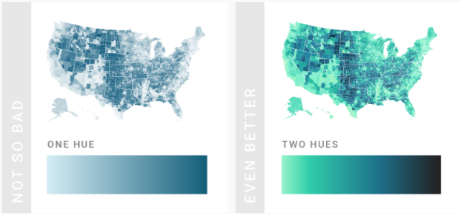
Consider using two hues for a gradient, not just one

Slide 17
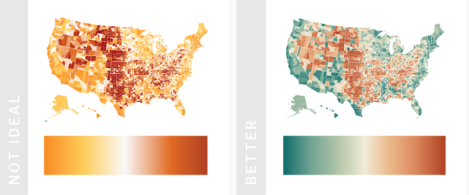
Consider using diverging color gradients

Slide 18
Reading
https://material.io/design/color/the-color-system.html#color-theme-creation
Let us play!!! Warning-Its addictive!!!
https://color.method.ac/

